Slide 1
Book recommender bot

Slide 2
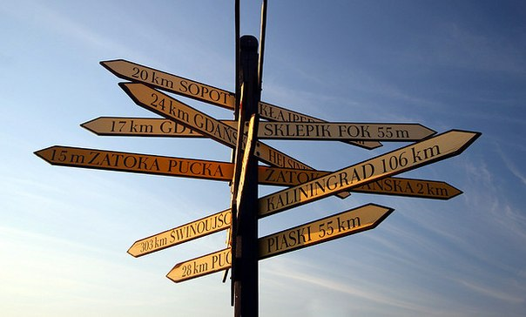
Too many choises

Slide 3
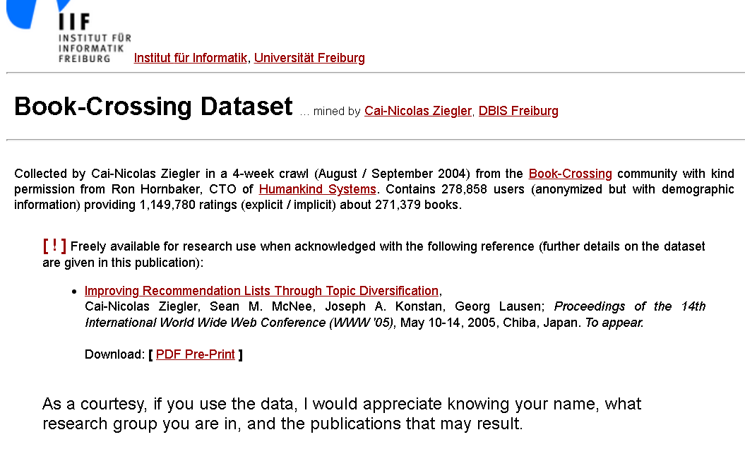
Let’s start with the first set of slides

Slide 4
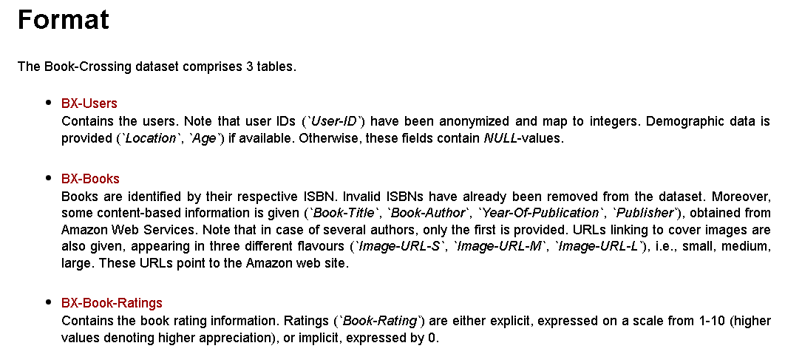

Slide 5
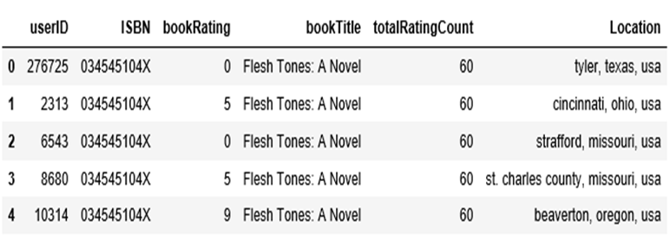
Books.head()

Slide 6
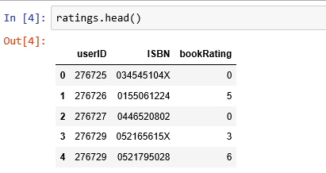
.

Slide 7
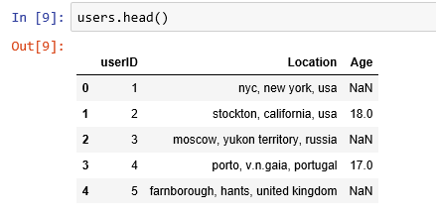

Slide 8
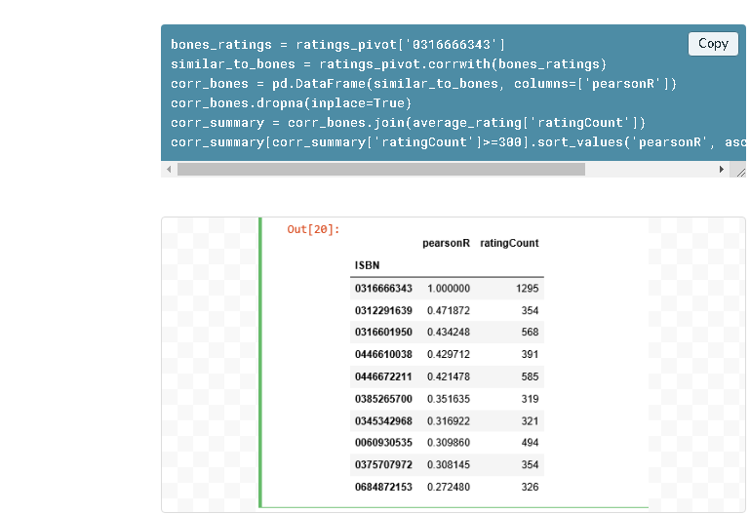
Code example of competitors

Slide 9
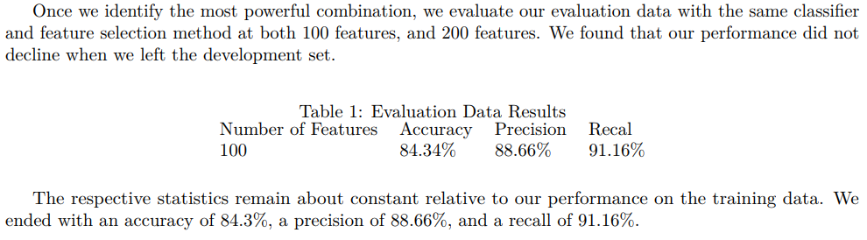
Accuracy of book recommender system
...and we hope to have the same result

Slide 10
What do we get from this project?
No stresses in finding what to read next.
No need to search for similar books
Bot can recommend you what to present someone, according to the book he\she has read

Slide 11
Thank you for your attention!

